Slide 1
COMMUNITY
RICOCHET EXCHANGE
SUNNY JAYCER
DECEMBER 21 2021
CALL #9

Slide 2

RICOCHET EXCHANGE
COMMUNITY CALL #9
SUNNY JAYCER
AGENDA
• Rex-products abstraction work
• LP incentives & Rex-Market
• Recap & outlook

Slide 3
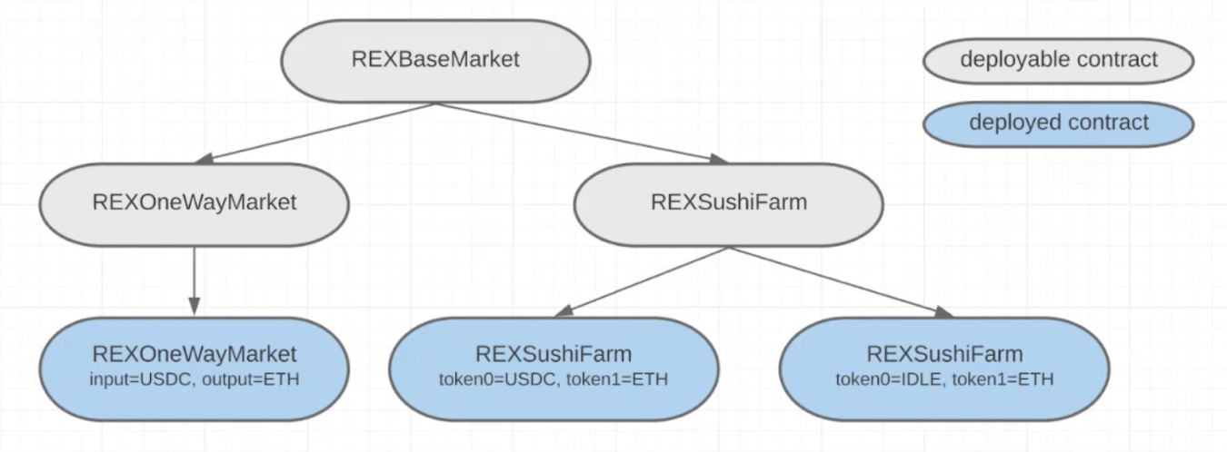
RICOCHET EXCHANGE
COMMUNITY CALL #9
SUNNY JAYCER
ARCHITECTURE
REXBaseMarket contains Superfluid integrations and IA share management
Level 2 shows the application specific extensions of the base
Level 3 contains deployed contracts, each initialized with different init params

Slide 4

RICOCHET EXCHANGE
COMMUNITY CALL #9
SUNNY JAYCER
IDLE DAO COLLABORATION
Incentives begin this Wednesday (12/23)
• USDC-IDLE rexMarket: $1,000 in $IDLE rewards over 30 days
• USDC-IDLE/WETH rexLP: $1,000 in $IDLE rewards over 30 days
Future
Stream invest into yield-bearing tokens
• DAI to idleDAO (+4.5% APR) example
• Support from Idle's Polygon Grant Program

Slide 5
THE NUMBERS
We’re growing. Fast.
TOTAL VALUE STREAMING (TVS)
ANNUALIZED VOLUME
RIC PRICE
$2.19M
$26.24M
$1.68
+175%
$525K REVENUE
$16.8M FDV | +79%
TREASURY BALANCE
USDCX ON LOAN
RIC IN TREASURY
$122K
$74K
$14.0M
+96%
$8.9K/YEAR IN REVENUE
8.3M RIC

Slide 6
SOME TABLE
TITLE

Slide 7

PRODUCT DISPLAY
One
What is this product
Two
What is this product

Slide 8






Font 1: Montserrat
Font 2: DM Sans
Font 3: DM Mono
RICOCHET RICOCHET
Navy: 1D2731
Light Blue: 6092C0
Light green: 81D048

Slide 9

Ricochet
Community Call #10

Slide 11


